Slide 1
C++ Programming:
From Problem Analysis to Program Design, Fourth Edition
Chapter 9: Arrays and Strings

Slide 2
Objectives
In this chapter, you will:
Learn about arrays
Explore how to declare and manipulate data into arrays
Understand the meaning of “array index out of bounds”
Become familiar with the restrictions on array processing
Discover how to pass an array as a parameter to a function
C++ Programming: From Problem Analysis to Program Design, Fourth Edition

Slide 3
Objectives (continued)
Learn about C-strings
Examine the use of string functions to process C-strings
Discover how to input data into—and output data from—a C-string
Learn about parallel arrays
Discover how to manipulate data in a two-dimensional array
Learn about multidimensional arrays
C++ Programming: From Problem Analysis to Program Design, Fourth Edition

Slide 4
Data Types
A data type is called simple if variables of that type can store only one value at a time
A structured data type is one in which each data item is a collection of other data items
C++ Programming: From Problem Analysis to Program Design, Fourth Edition

Slide 5
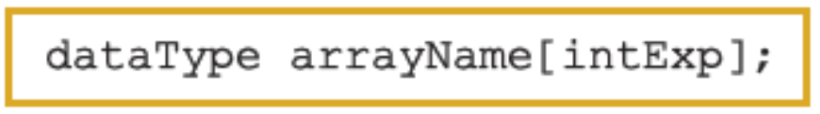
Arrays
Array: a collection of a fixed number of components wherein all of the components have the same data type
In a one-dimensional array, the components are arranged in a list form
Syntax for declaring a one-dimensional array:
intExp evaluates to a positive integer
C++ Programming: From Problem Analysis to Program Design, Fourth Edition

Slide 6
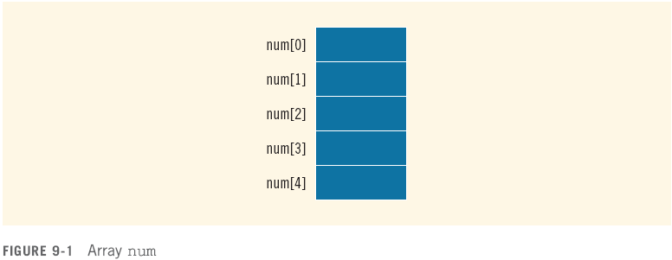
Arrays (continued)
Example:
int num[5];
C++ Programming: From Problem Analysis to Program Design, Fourth Edition

Slide 7
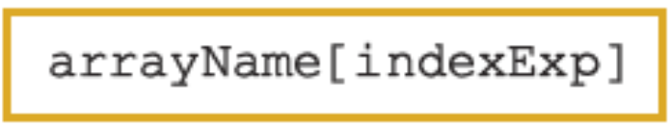
Accessing Array Components
General syntax:
where indexExp, called an index, is any expression whose value is a nonnegative integer
Index value specifies the position of the component in the array
[] is the array subscripting operator
The array index always starts at 0
C++ Programming: From Problem Analysis to Program Design, Fourth Edition

Slide 8

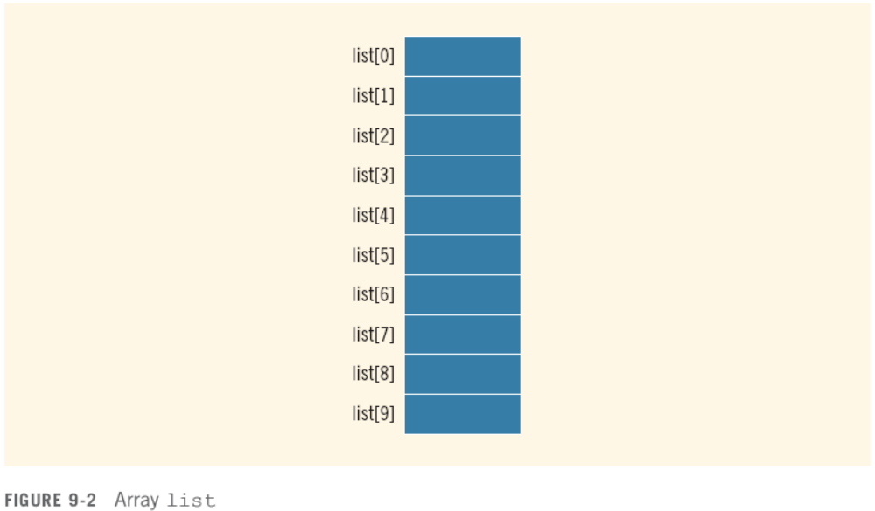
Accessing Array Components (continued)
C++ Programming: From Problem Analysis to Program Design, Fourth Edition

Slide 9

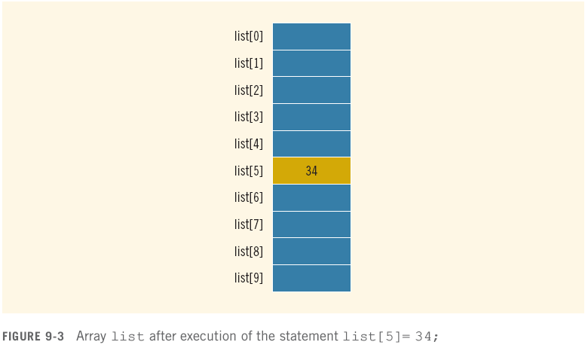
Accessing Array Components (continued)
C++ Programming: From Problem Analysis to Program Design, Fourth Edition

Slide 10
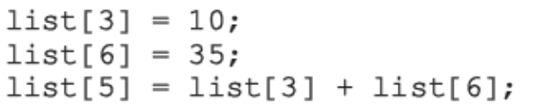
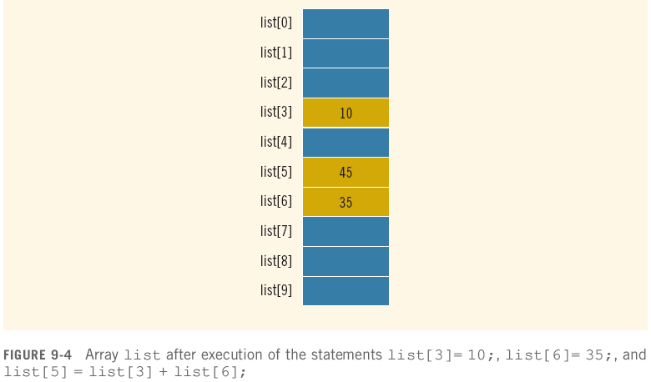
Accessing Array Components (continued)
C++ Programming: From Problem Analysis to Program Design, Fourth Edition

Slide 11
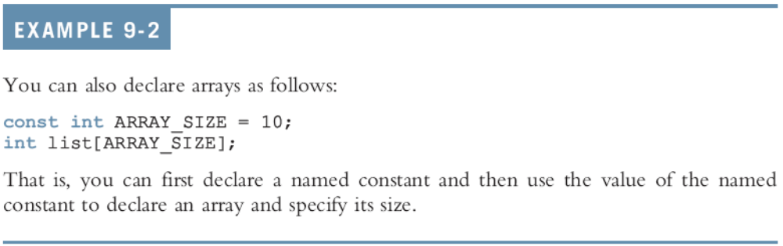
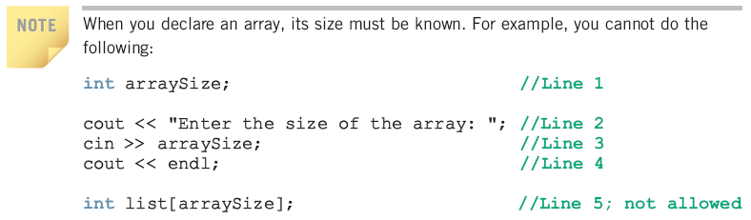
Accessing Array Components (continued)
C++ Programming: From Problem Analysis to Program Design, Fourth Edition

Slide 12
Processing One-Dimensional Arrays
Some basic operations performed on a one-dimensional array are:
  Initializing
  Inputting data
  Outputting data stored in an array
  Finding the largest and/or smallest element
Each operation requires ability to step through the elements of the array
Easily accomplished by a loop
C++ Programming: From Problem Analysis to Program Design, Fourth Edition

Slide 13
Processing One-Dimensional Arrays (continued)
Consider the declaration
int list[100]; //array of size 100
int i;
Using for loops to access array elements:
for (i = 0; i < 100; i++) //Line 1
//process list[i] //Line 2
Example:
for (i = 0; i < 100; i++) //Line 1
cin >> list[i]; //Line 2
C++ Programming: From Problem Analysis to Program Design, Fourth Edition

Slide 14
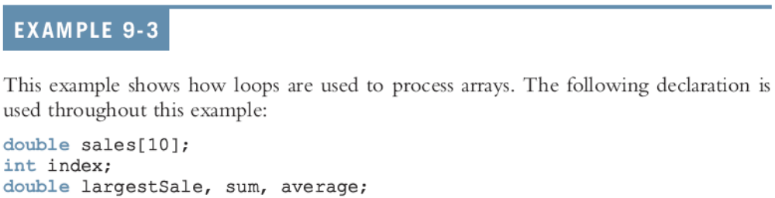





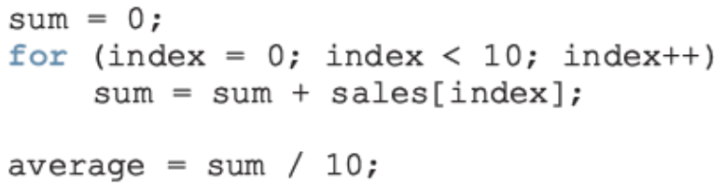
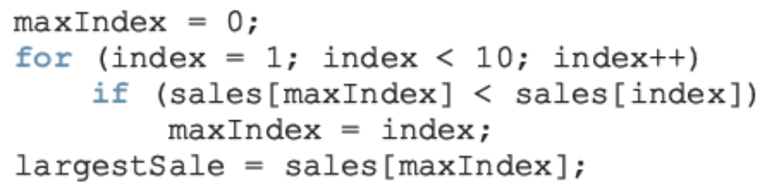

Slide 15
Array Index Out of Bounds
If we have the statements:
double num[10];
int i;
The component num[i] is valid if i = 0, 1, 2, 3, 4, 5, 6, 7, 8, or 9
The index of an array is in bounds if the index >=0 and the index <= ARRAY_SIZE-1
  Otherwise, we say the index is out of bounds
In C++, there is no guard against indices that are out of bounds
C++ Programming: From Problem Analysis to Program Design, Fourth Edition

Slide 16
Array Initialization During Declaration
Arrays can be initialized during declaration
  In this case, it is not necessary to specify the size of the array
    Size determined by the number of initial values in the braces
Example:
double sales[] = {12.25, 32.50, 16.90, 23, 45.68};
C++ Programming: From Problem Analysis to Program Design, Fourth Edition

Slide 17
Partial Initialization of Arrays During Declaration
The statement:
int list[10] = {0};
declares list to be an array of 10 components and initializes all of them to zero
The statement:
int list[10] = {8, 5, 12};
declares list to be an array of 10 components, initializes list[0] to 8, list[1] to 5, list[2] to 12 and all other components are initialized to 0
C++ Programming: From Problem Analysis to Program Design, Fourth Edition

Slide 18
Partial Initialization of Arrays During Declaration (continued)
The statement:
int list[] = {5, 6, 3};
  declares list to be an array of 3 components and initializes list[0] to 5, list[1] to 6, and list[2] to 3
The statement:
int list[25]= {4, 7};
  declares an array of 25 components; initializes list[0] to 4 and list[1] to 7; all other components are initialized to 0
C++ Programming: From Problem Analysis to Program Design, Fourth Edition

Slide 19
Some Restrictions on Array Processing
Consider the following statements:
C++ does not allow aggregate operations on an array:
Solution:
C++ Programming: From Problem Analysis to Program Design, Fourth Edition

Slide 20


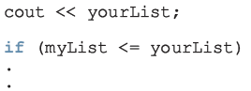
Some Restrictions on Array Processing (continued)
The following is illegal too:
Solution:
The following statements are legal, but do not give the desired results:
C++ Programming: From Problem Analysis to Program Design, Fourth Edition

Slide 21
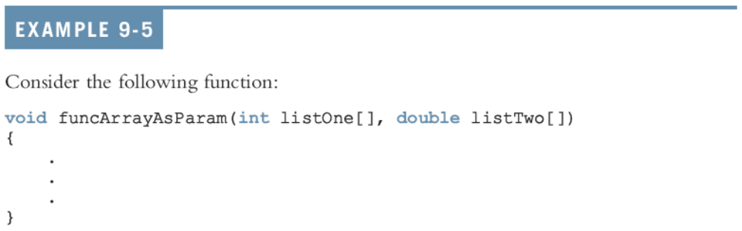
Arrays as Parameters to Functions
Arrays are passed by reference only
The symbol & is not used when declaring an array as a formal parameter
The size of the array is usually omitted
  If provided, it is ignored by the compiler
C++ Programming: From Problem Analysis to Program Design, Fourth Edition

Slide 22
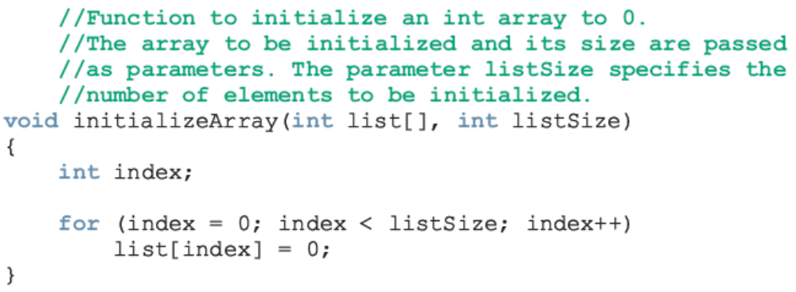
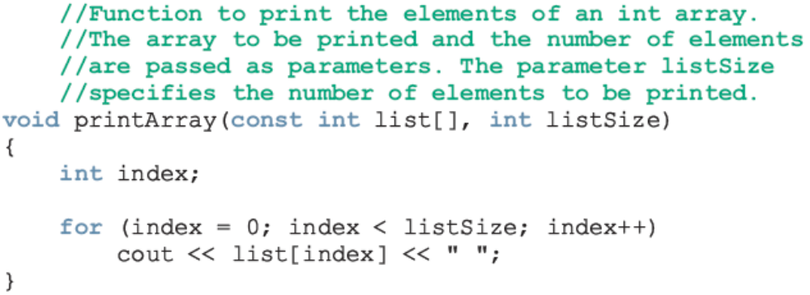
Constant Arrays as Formal Parameters
C++ Programming: From Problem Analysis to Program Design, Fourth Edition

Slide 23
Base Address of an Array and Array in Computer Memory
The base address of an array is the address, or memory location of the first array component
If list is a one-dimensional array, its base address is the address of list[0]
When we pass an array as a parameter, the base address of the actual array is passed to the formal parameter
C++ Programming: From Problem Analysis to Program Design, Fourth Edition

Slide 24
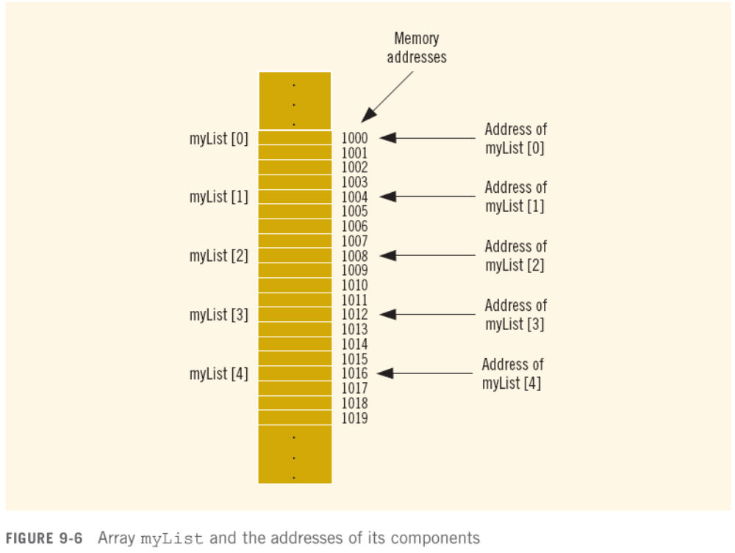

Slide 25
Functions Cannot Return a Value of the Type Array
C++ does not allow functions to return a value of the type array
C++ Programming: From Problem Analysis to Program Design, Fourth Edition

Slide 26
Integral Data Type and Array Indices
C++ allows any integral type to be used as an array index
Example:
C++ Programming: From Problem Analysis to Program Design, Fourth Edition

Slide 27
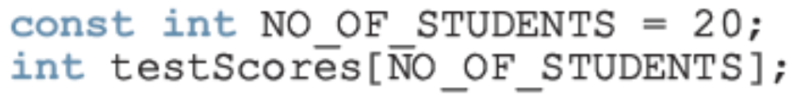
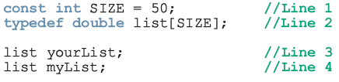
Other Ways to Declare Arrays
C++ Programming: From Problem Analysis to Program Design, Fourth Edition

Slide 28
C-Strings (Character Arrays)
Character array: an array whose components are of type char
C-strings are null-terminated ('\0') character arrays
Example:
  'A' is the character A
  "A" is the C-string A
    "A" represents two characters, 'A' and '\0‘
C++ Programming: From Problem Analysis to Program Design, Fourth Edition

Slide 29
C-Strings (Character Arrays) (continued)
Consider the statement
char name[16];
Since C-strings are null terminated and name has 16 components, the largest string that it can store has 15 characters
If you store a string of length, say 10 in name
  The first 11 components of name are used and the last five are left unused
C++ Programming: From Problem Analysis to Program Design, Fourth Edition

Slide 30
C-Strings (Character Arrays) (continued)
The statement
char name[16] = "John";
declares an array name of length 16 and stores the C-string "John" in it
The statement
char name[] = "John";
declares an array name of length 5 and stores the C-string "John" in it
C++ Programming: From Problem Analysis to Program Design, Fourth Edition

Slide 31
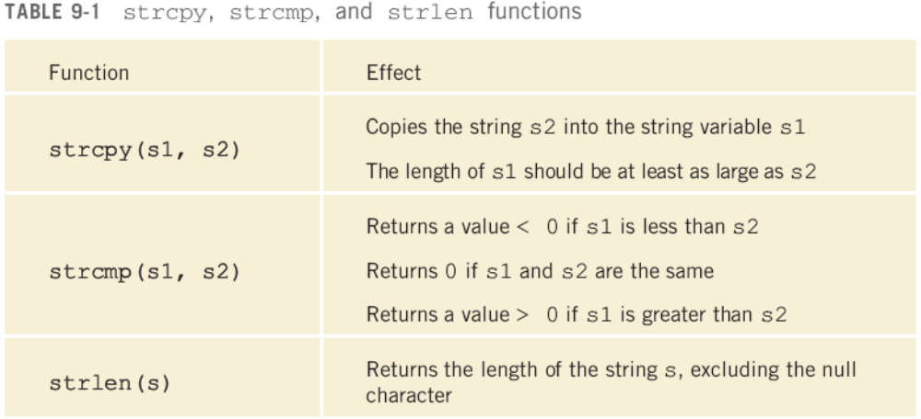
C-Strings (Character Arrays) (continued)
C++ Programming: From Problem Analysis to Program Design, Fourth Edition

Slide 32
String Comparison
C-strings are compared character by character using the collating sequence of the system
If we are using the ASCII character set
  "Air" < "Boat"
  "Air" < "An"
  "Bill" < "Billy"
  "Hello" < "hello"
C++ Programming: From Problem Analysis to Program Design, Fourth Edition

Slide 33
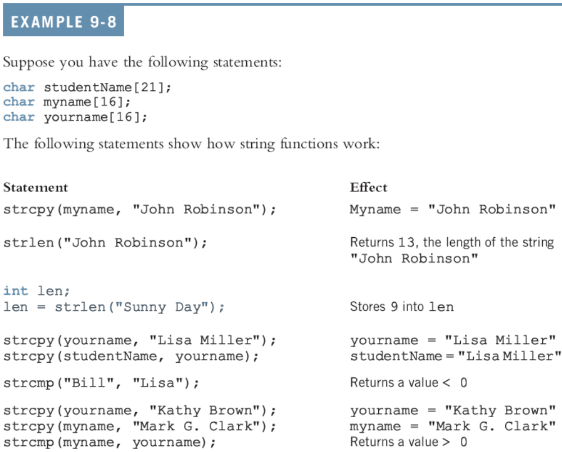

Slide 34
Reading and Writing Strings
Most rules that apply to arrays apply to C-strings as well
Aggregate operations, such as assignment and comparison, are not allowed on arrays
Even the input/output of arrays is done component-wise
The one place where C++ allows aggregate operations on arrays is the input and output of C-strings (that is, character arrays)
C++ Programming: From Problem Analysis to Program Design, Fourth Edition

Slide 35
String Input
cin >> name; stores the next input C-string into name
To read strings with blanks, use get:
cin.get(str, m+1);
  Stores the next m characters into str but the newline character is not stored in str
  If the input string has fewer than m characters, the reading stops at the newline character
C++ Programming: From Problem Analysis to Program Design, Fourth Edition

Slide 36
String Output
cout << name; outputs the content of name on the screen
  << continues to write the contents of name until it finds the null character
  If name does not contain the null character, then we will see strange output
    << continues to output data from memory adjacent to name until '\0' is found
C++ Programming: From Problem Analysis to Program Design, Fourth Edition

Slide 37
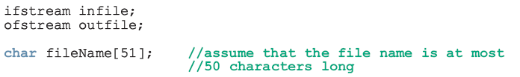
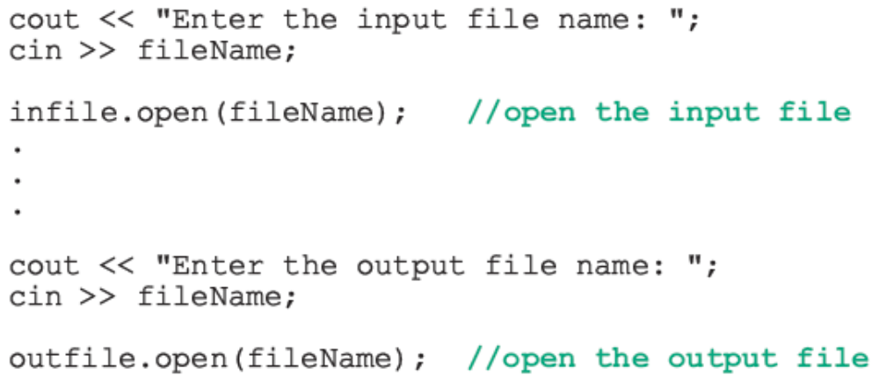
Specifying Input/Output Files at Execution Time
You can let the user specify the name of the input and/or output file at execution time:
C++ Programming: From Problem Analysis to Program Design, Fourth Edition

Slide 38
string Type and Input/Output Files
Argument to the function open must be a null-terminated string (a C-string)
If we use a variable of type string to read the name of an I/O file, the value must first be converted to a C-string before calling open
Syntax:
strVar.c_str()
  where strVar is a variable of type string
C++ Programming: From Problem Analysis to Program Design, Fourth Edition

Slide 39
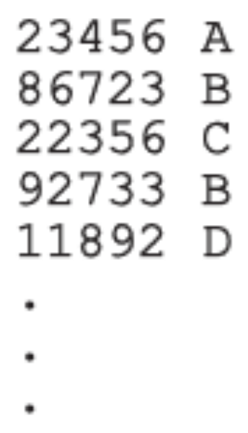
Parallel Arrays
Two (or more) arrays are called parallel if their corresponding components hold related information
Example:
  int studentId[50];
  char courseGrade[50];
C++ Programming: From Problem Analysis to Program Design, Fourth Edition

Slide 40

Two-Dimensional Arrays
Two-dimensional array: collection of a fixed number of components (of the same type) arranged in two dimensions
  Sometimes called matrices or tables
Declaration syntax:
  where intexp1 and intexp2 are expressions yielding positive integer values, and specify the number of rows and the number of columns, respectively, in the array
C++ Programming: From Problem Analysis to Program Design, Fourth Edition

Slide 41

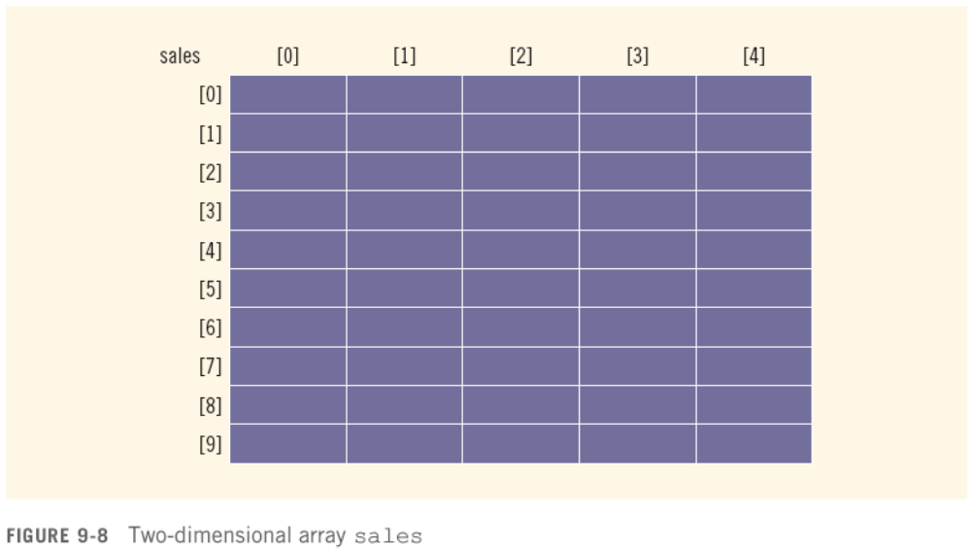
Two-Dimensional Arrays (continued)
C++ Programming: From Problem Analysis to Program Design, Fourth Edition

Slide 42

Accessing Array Components
Syntax:
  where indexexp1 and indexexp2 are expressions yielding nonnegative integer values, and specify the row and column position
C++ Programming: From Problem Analysis to Program Design, Fourth Edition

Slide 43
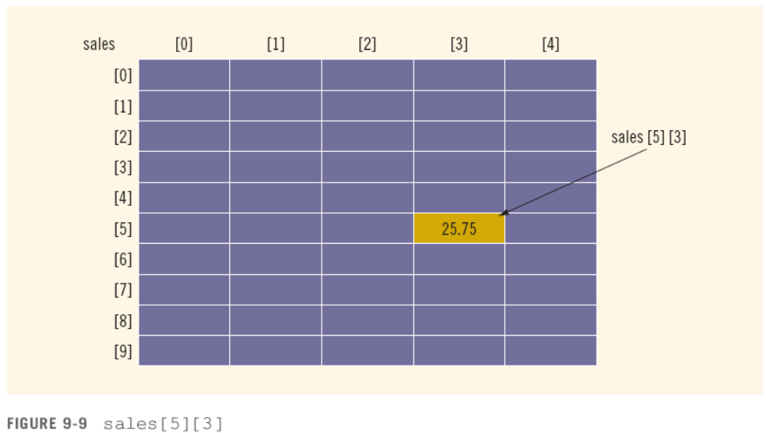
Accessing Array Components (continued)
C++ Programming: From Problem Analysis to Program Design, Fourth Edition

Slide 44

Two-Dimensional Array Initialization During Declaration
Two-dimensional arrays can be initialized when they are declared:
  Elements of each row are enclosed within braces and separated by commas
  All rows are enclosed within braces
  For number arrays, if all components of a row aren’t specified, unspecified ones are set to 0
C++ Programming: From Problem Analysis to Program Design, Fourth Edition

Slide 45

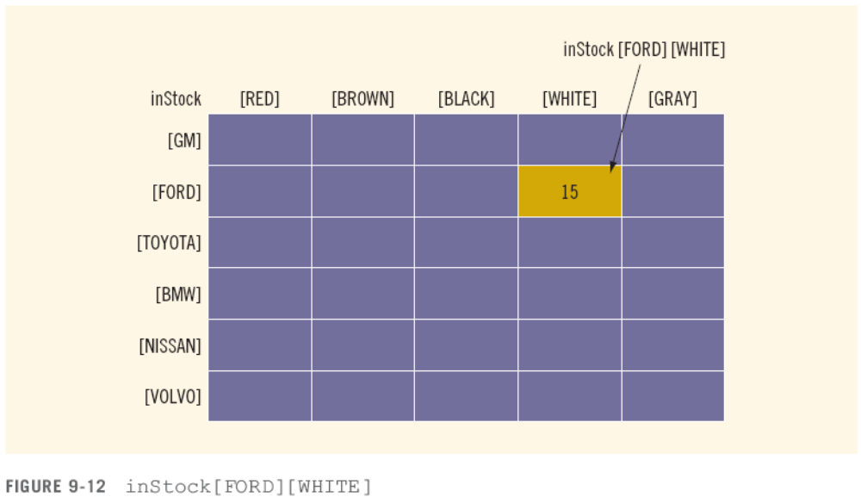
Two-Dimensional Arrays and Enumeration Types
C++ Programming: From Problem Analysis to Program Design, Fourth Edition

Slide 46
Processing Two-Dimensional Arrays
Ways to process a two-dimensional array:
  Process the entire array
  Process a particular row of the array, called row processing
  Process a particular column of the array, called column processing
Each row and each column of a two-dimensional array is a one-dimensional array
  To process, use algorithms similar to processing one-dimensional arrays
C++ Programming: From Problem Analysis to Program Design, Fourth Edition

Slide 47
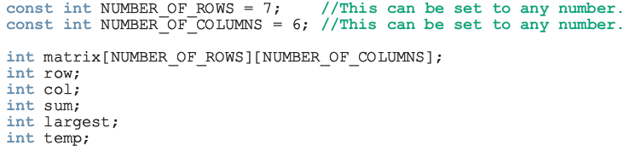
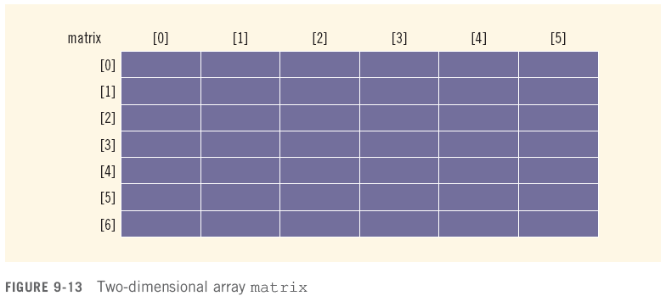
Processing Two-Dimensional Arrays (continued)
C++ Programming: From Problem Analysis to Program Design, Fourth Edition

Slide 48
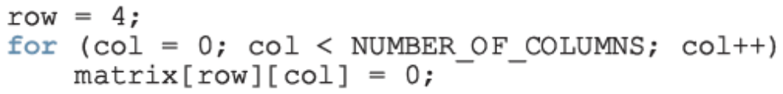

Initialization
To initialize row number 4 (i.e., fifth row) to 0
To initialize the entire matrix to 0:
C++ Programming: From Problem Analysis to Program Design, Fourth Edition

Slide 49
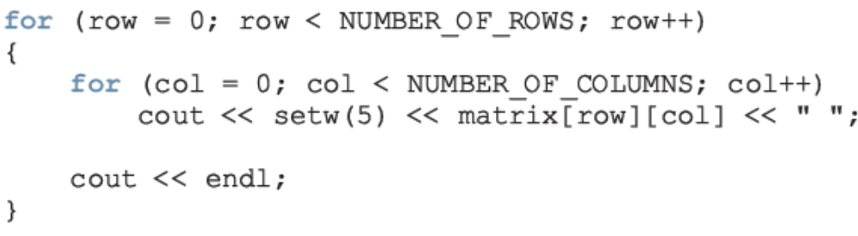
Print
To output the components of matrix:
C++ Programming: From Problem Analysis to Program Design, Fourth Edition

Slide 50
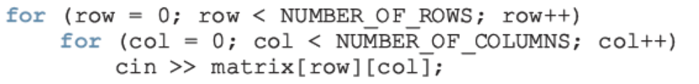
Input
To input data into each component of matrix:
C++ Programming: From Problem Analysis to Program Design, Fourth Edition

Slide 51
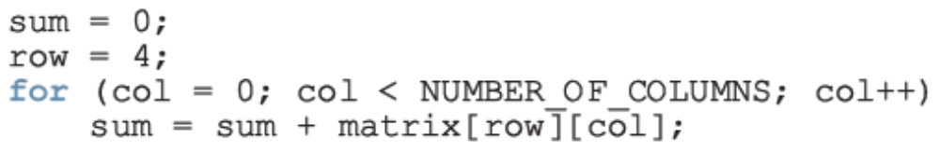
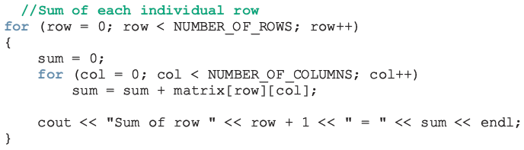
Sum by Row
To find the sum of row number 4 of matrix:
To find the sum of each individual row:
C++ Programming: From Problem Analysis to Program Design, Fourth Edition

Slide 52
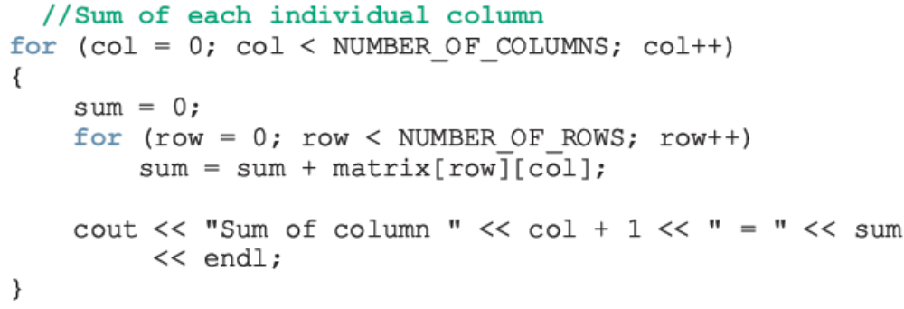
Sum by Column
To find the sum of each individual column:
C++ Programming: From Problem Analysis to Program Design, Fourth Edition

Slide 53
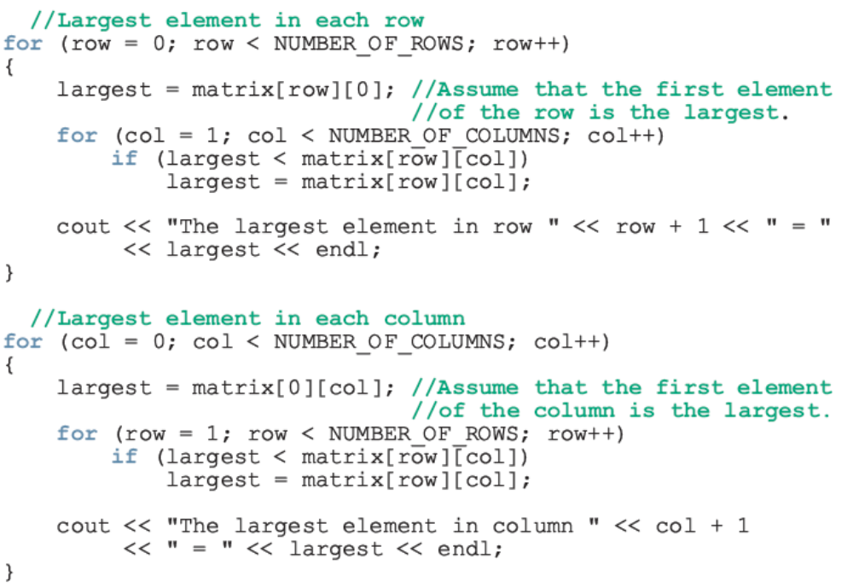
Largest Element in Each Row and Each Column
C++ Programming: From Problem Analysis to Program Design, Fourth Edition

Slide 54
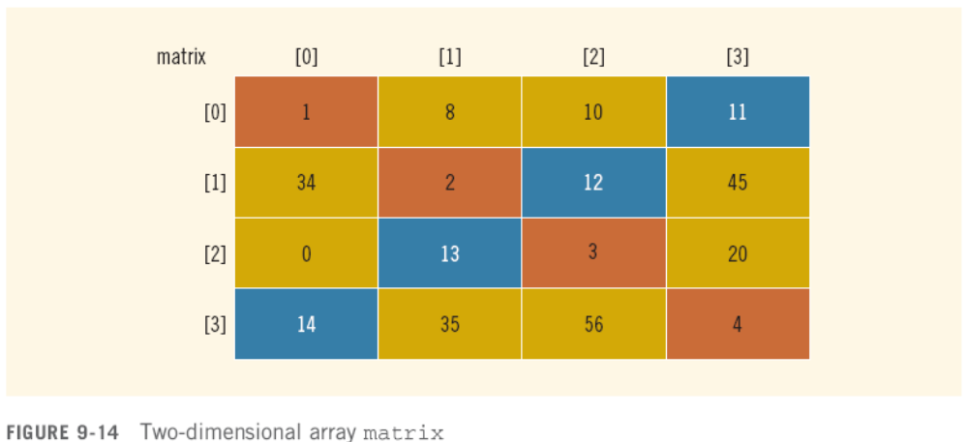
Reversing Diagonal
Before:
C++ Programming: From Problem Analysis to Program Design, Fourth Edition

Slide 55
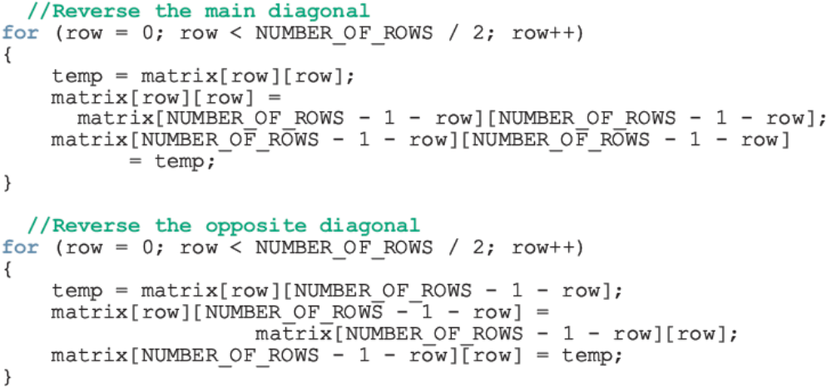
Reversing Diagonal (continued)
To reverse both the diagonals:
C++ Programming: From Problem Analysis to Program Design, Fourth Edition

Slide 56
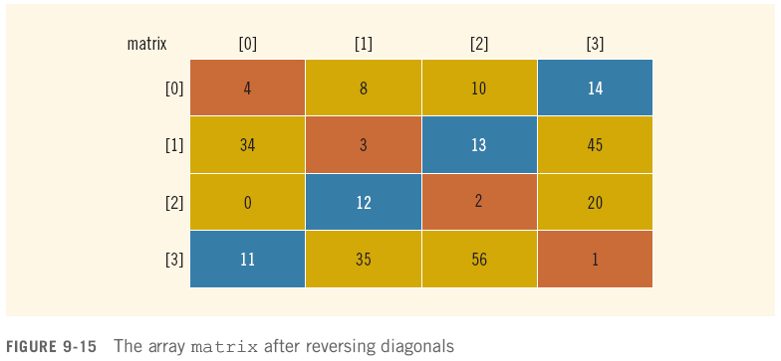
Reversing Diagonal (continued)
After:
C++ Programming: From Problem Analysis to Program Design, Fourth Edition

Slide 57
Passing Two-Dimensional Arrays as Parameters to Functions
Two-dimensional arrays can be passed as parameters to a function
  Pass by reference
    Base address (address of first component of the actual parameter) is passed to formal parameter
Two-dimensional arrays are stored in row order
When declaring a two-dimensional array as a formal parameter, can omit size of first dimension, but not the second
C++ Programming: From Problem Analysis to Program Design, Fourth Edition

Slide 58
Arrays of Strings
Strings in C++ can be manipulated using either the data type string or character arrays (C-strings)
On some compilers, the data type string may not be available in Standard C++ (i.e., non-ANSI/ISO Standard C++)
C++ Programming: From Problem Analysis to Program Design, Fourth Edition

Slide 59
Arrays of Strings and the string Type
To declare an array of 100 components of type string:
  string list[100];
Basic operations, such as assignment, comparison, and input/output, can be performed on values of the string type
The data in list can be processed just like any one-dimensional array
C++ Programming: From Problem Analysis to Program Design, Fourth Edition

Slide 60

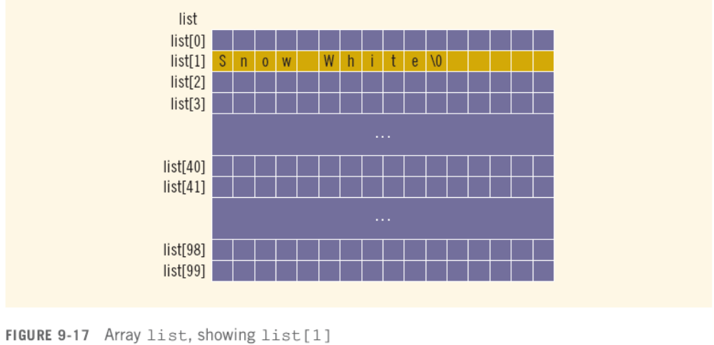

Arrays of Strings and C-Strings (Character Arrays)
C++ Programming: From Problem Analysis to Program Design, Fourth Edition

Slide 61


Another Way to Declare a Two-Dimensional Array
Consider the following:
To declare an array of 20 rows and 10 columns:
C++ Programming: From Problem Analysis to Program Design, Fourth Edition

Slide 62
Multidimensional Arrays
Multidimensional array: collection of a fixed number of elements (called components) arranged in n dimensions (n >= 1)
  Also called an n-dimensional array
Declaration syntax:
To access a component:
C++ Programming: From Problem Analysis to Program Design, Fourth Edition

Slide 63
Multidimensional Arrays (continued)
When declaring a multidimensional array as a formal parameter in a function
  Can omit size of first dimension but not other dimensions
As parameters, multidimensional arrays are passed by reference only
A function cannot return a value of the type array
There is no check if the array indices are within bounds
C++ Programming: From Problem Analysis to Program Design, Fourth Edition

Slide 64
Programming Example: Code Detection
When a message is transmitted in secret code over a transmission channel, it is usually transmitted as a sequence of bits (0s and 1s)
Due to noise in the transmission channel, the transmitted message may become corrupted
  Message received at destination is not the same as the message transmitted
  Some of the bits may have been changed
C++ Programming: From Problem Analysis to Program Design, Fourth Edition

Slide 65
Programming Example: Code Detection (continued)
Several techniques to check the validity of the transmitted message at the destination
One technique is to transmit the same message twice
  At the destination, both copies of the message are compared bit by bit
  If the corresponding bits are the same, the message received is error-free
C++ Programming: From Problem Analysis to Program Design, Fourth Edition

Slide 66
Programming Example: Code Detection (continued)
We write a program to check if the message received at the destination is error-free
For simplicity, assume that:
  The secret code representing the message is a sequence of digits (0 to 9)
  The maximum length of the message is 250 digits
The first number in the message is the length of the message
C++ Programming: From Problem Analysis to Program Design, Fourth Edition

Slide 67
Programming Example: Code Detection (continued)
If the secret code is
7 9 2 7 8 3 5 6
then the message is seven digits long
The above message is transmitted (twice) as
7 9 2 7 8 3 5 6 7 9 2 7 8 3 5 6
Input: a file containing the secret code and its copy
Output: the secret code, its copy, and a message if the received code is error-free
C++ Programming: From Problem Analysis to Program Design, Fourth Edition

Slide 68
Programming Example: Code Detection (continued)
The results are output in the following form:
Code Digit Code Digit Copy
9 9
2 2
7 7
8 8
3 3
5 5
6 6
Message transmitted OK
C++ Programming: From Problem Analysis to Program Design, Fourth Edition

Slide 69
Programming Example: Problem Analysis
Because we have to compare digits of the secret code and its copy:
  First, read the secret code and store it in an array
  Next, read first digit of the copy and compare it with the first digit of the code, and so on
  If any corresponding digits are not the same, print a message next to the digits
The first number in the secret code, and in the copy, indicates the length of the code
C++ Programming: From Problem Analysis to Program Design, Fourth Edition

Slide 70
Programming Example: Algorithm Design
Open the input and output files
If the input file does not exist, exit the program
Read the length of the secret code
If the length of the secret code is greater than 250, terminate the program because the maximum length of the code in this program is 250
Read and store the secret code into an array
C++ Programming: From Problem Analysis to Program Design, Fourth Edition

Slide 71
Programming Example: Algorithm Design (continued)
Read the length of the copy
If the length of the secret code and its copy are the same, compare the codes; otherwise, print an error message
Note: To simplify function main, write a function, readCode, to read the secret code and another function, compareCode, to compare the codes
C++ Programming: From Problem Analysis to Program Design, Fourth Edition

Slide 72
Programming Example: readCode
First, read length of secret code
If length of secret code is greater than 250
  Set lenCodeOk (a reference parameter) to false and the function terminates
Value of lenCodeOk is passed to calling function to indicate if secret code was read successfully
If length of code is less than 250, readCode reads and stores secret code into an array
C++ Programming: From Problem Analysis to Program Design, Fourth Edition

Slide 73
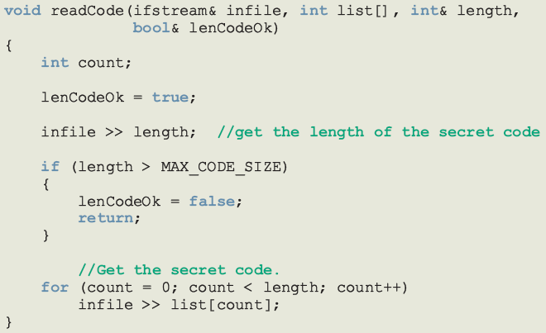
Programming Example: readCode (continued)
C++ Programming: From Problem Analysis to Program Design, Fourth Edition

Slide 74
Programming Example: compareCode
Set a bool variable codeOk to true
If length of code and copy are not equal
  Output error message and terminate function
For each digit in input file
  Read the next digit of secret code copy
  Output digits from code and copy
  If corresponding digits are not equal, output error message and set codeOk to false
If codeOk, output message indicating code transmitted OK, else output an error message
C++ Programming: From Problem Analysis to Program Design, Fourth Edition

Slide 75
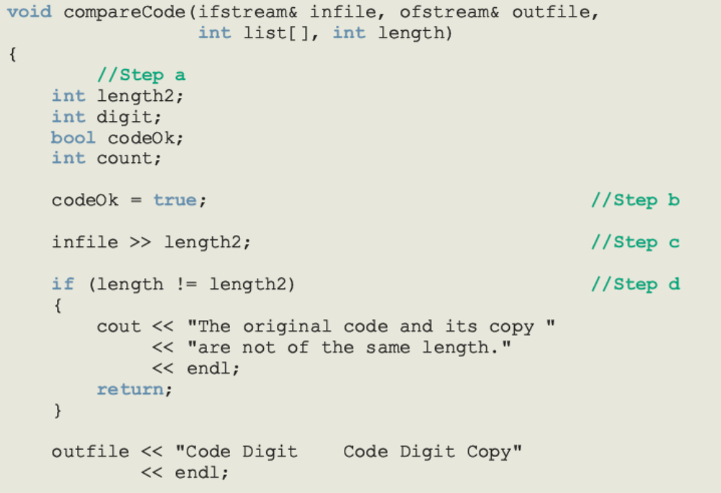
Programming Example: compareCode (continued)
C++ Programming: From Problem Analysis to Program Design, Fourth Edition

Slide 76
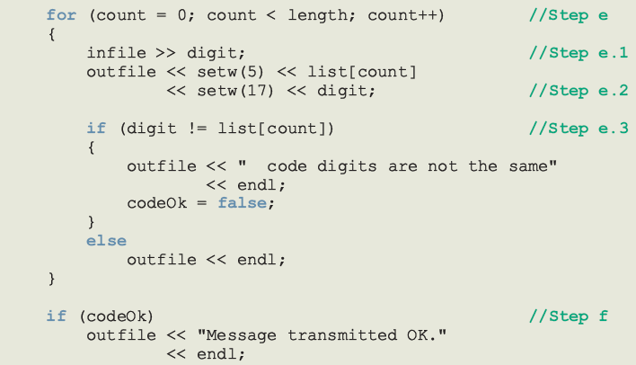
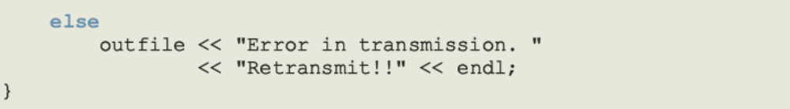
Programming Example: compareCode (continued)
C++ Programming: From Problem Analysis to Program Design, Fourth Edition

Slide 77
Programming Example: Main Algorithm
Declare variables
Open the files
Call readCode to read the secret code
If (length of the secret code <= 250)
  Call compareCode to compare the codes
  else
  Output an appropriate error message
C++ Programming: From Problem Analysis to Program Design, Fourth Edition

Slide 78
Summary
Array: structured data type with a fixed number of components of the same type
  Components are accessed using their relative positions in the array
Elements of a one-dimensional array are arranged in the form of a list
An array index can be any expression that evaluates to a nonnegative integer
  Must always be less than the size of the array
C++ Programming: From Problem Analysis to Program Design, Fourth Edition

Slide 79
Summary (continued)
The base address of an array is the address of the first array component
When passing an array as an actual parameter, you use only its name
  Passed by reference only
A function cannot return a value of the type array
In C++, C-strings are null terminated and are stored in character arrays
C++ Programming: From Problem Analysis to Program Design, Fourth Edition

Slide 80
Summary (continued)
Commonly used C-string manipulation functions include:
  strcpy, strcmp, and strlen
Parallel arrays are used to hold related information
In a two-dimensional array, the elements are arranged in a table form
C++ Programming: From Problem Analysis to Program Design, Fourth Edition

Slide 81
Summary
To access an element of a two-dimensional array, you need a pair of indices:
  One for the row position
  One for the column position
In row processing, a two-dimensional array is processed one row at a time
In column processing, a two-dimensional array is processed one column at a time
C++ Programming: From Problem Analysis to Program Design, Fourth Edition

